Slide 1
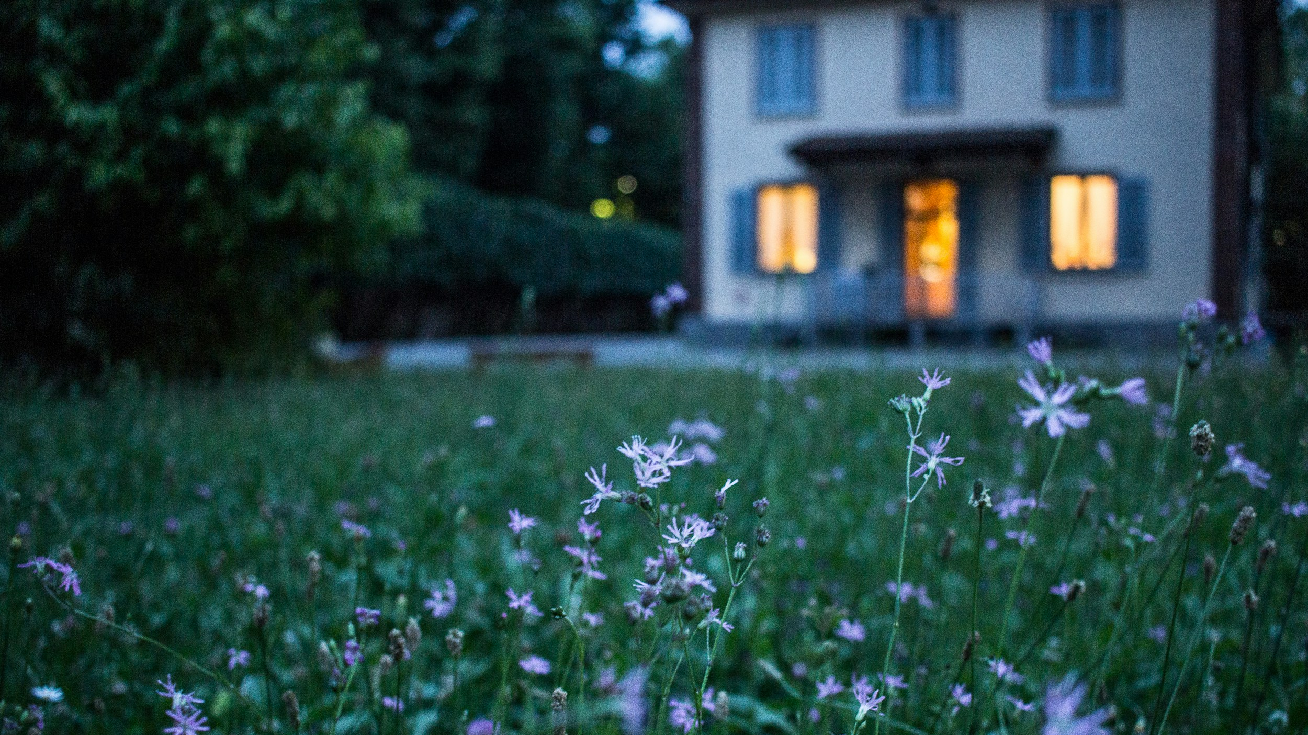
Dining with a Dane

Slide 2
Set the scene... Hvad er det for en aften...
Big Hall, hvor mange gæster (alder på gæster)

Slide 3
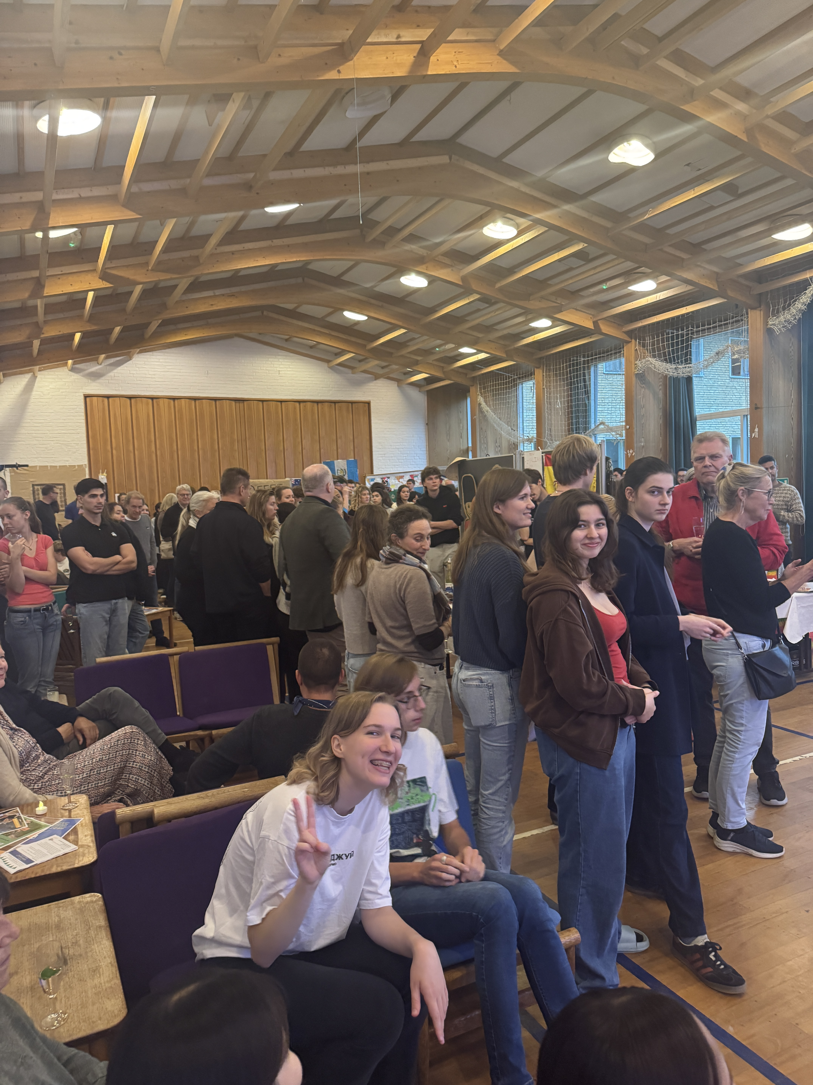
Hosting in ‘fællesskab’
Revisit – 19th of March

Slide 4
In Regional Groups – brainstorm:
Activity
Food
Creative team
Decide on roles

Slide 5
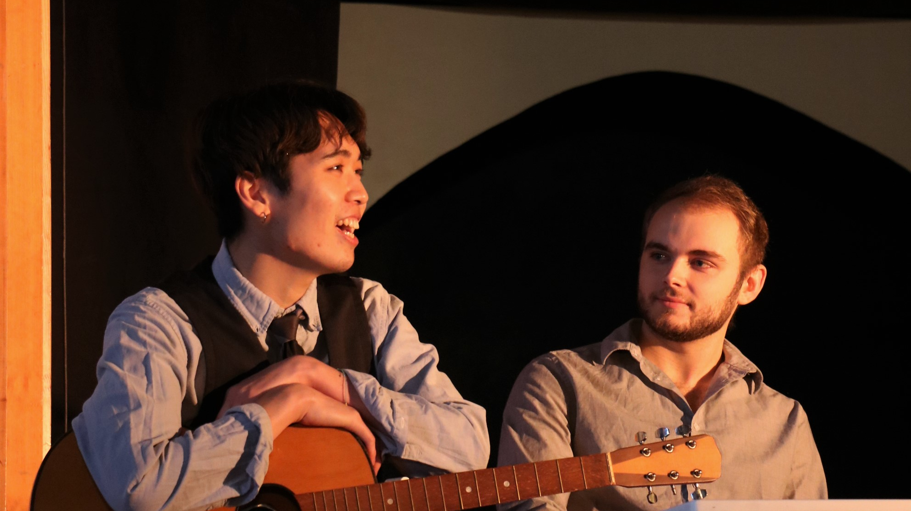
Activity
One person / group performance

Slide 6
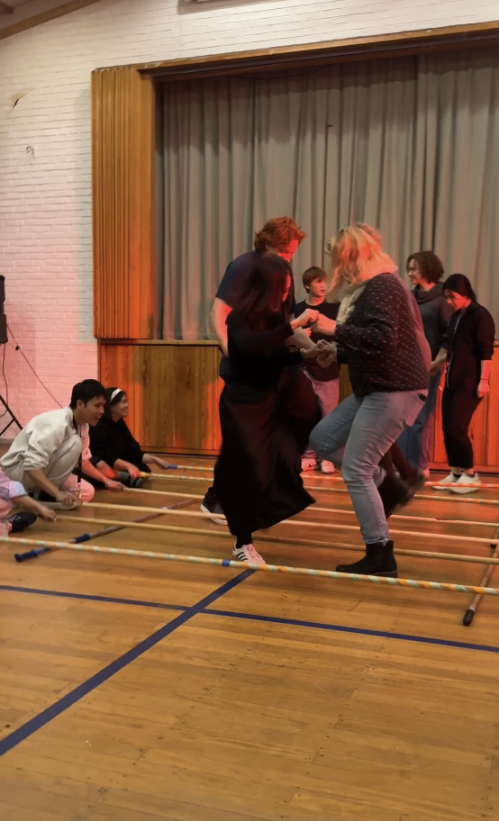
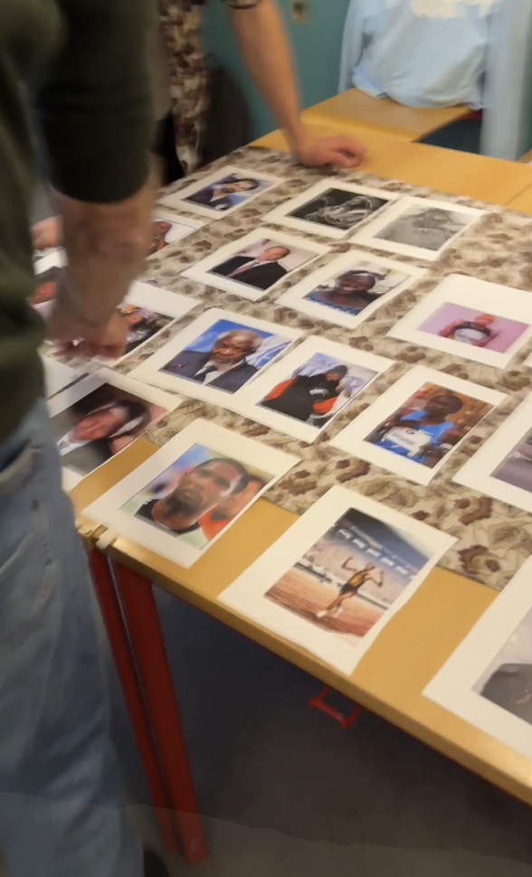
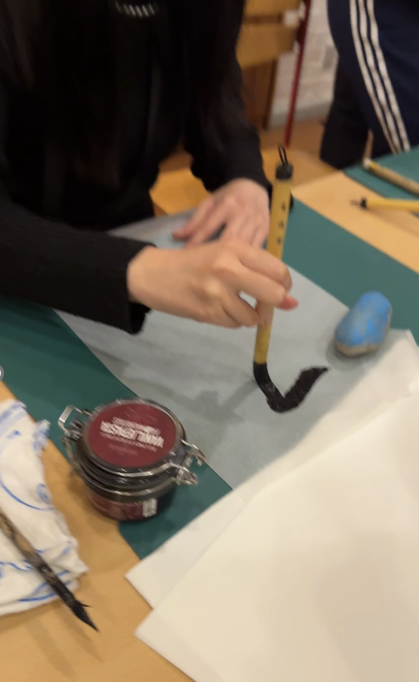
Activity
An engaging activity
Fun and games… or more serious

Slide 7
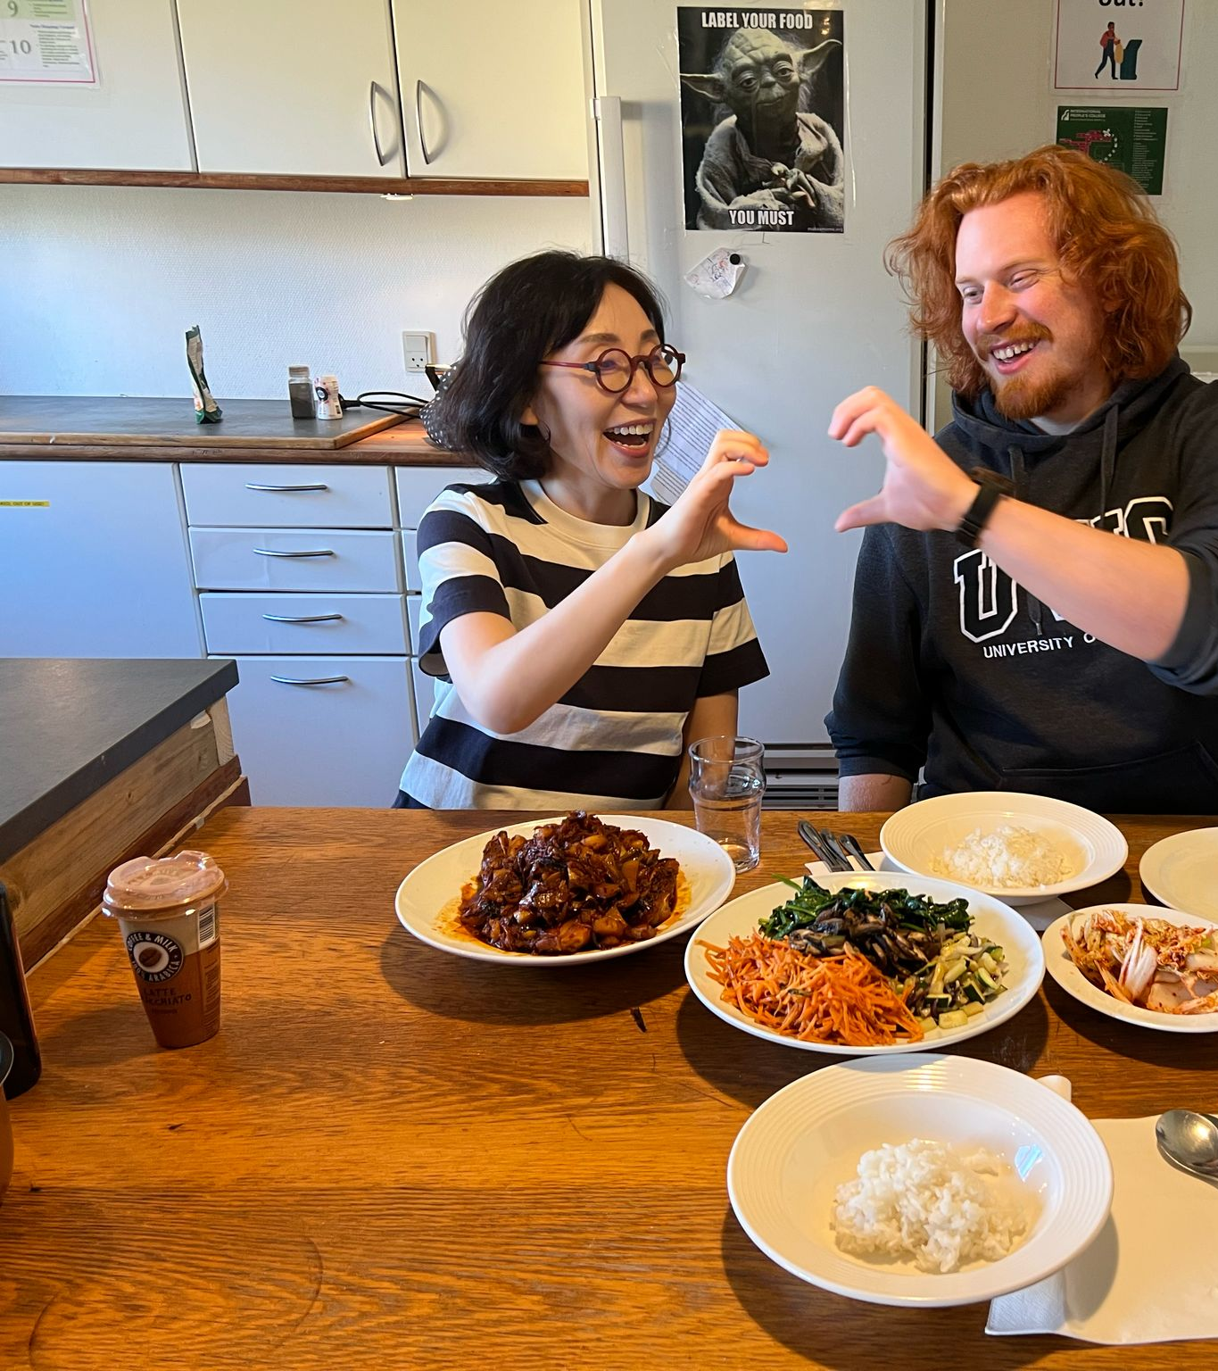
2) Food preps
3 students in each regional group are ‘food preps’
Food preps meet up with the kitchen TOMORROW after lunch (13.15) in Manor House and suggest a few dishes they would like to make (one dish per group)

Slide 8
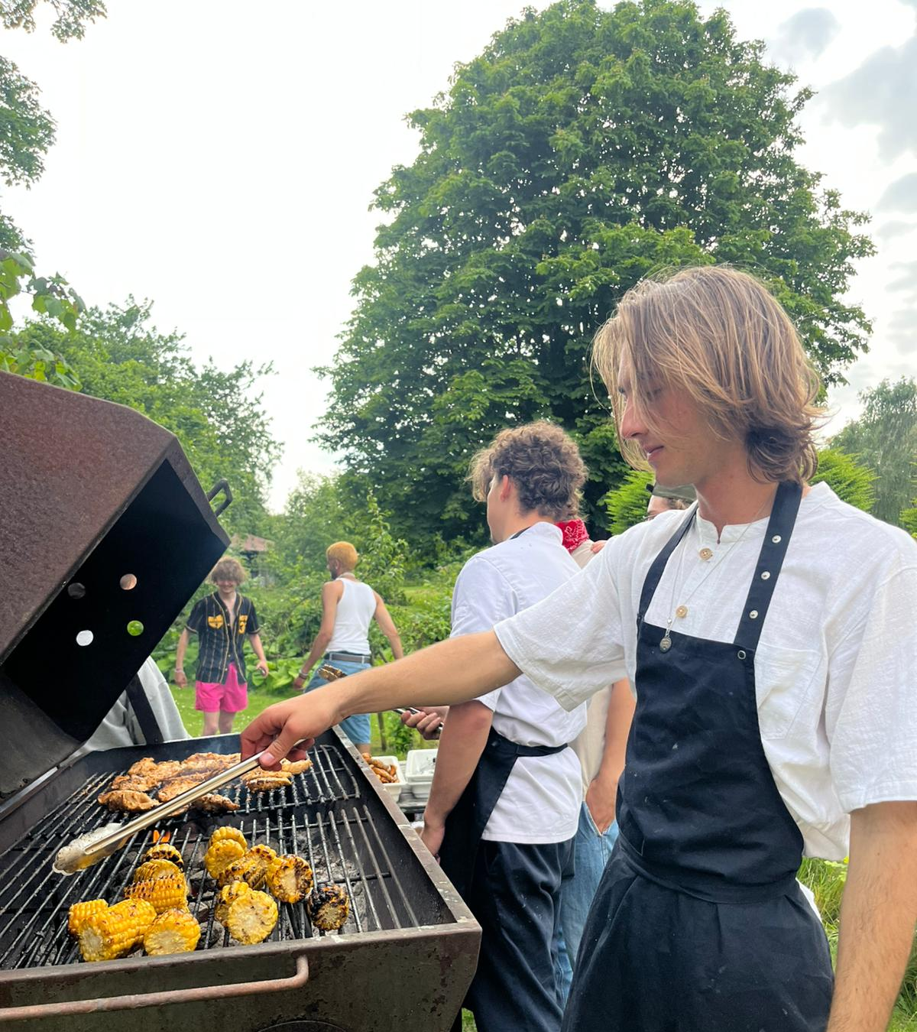
2) Food preps
Food preps will be allowed absence in classes on the 19th and cook all day
They will also present their dish to the guest on the evening and serve the food (with help from the group)

Slide 9
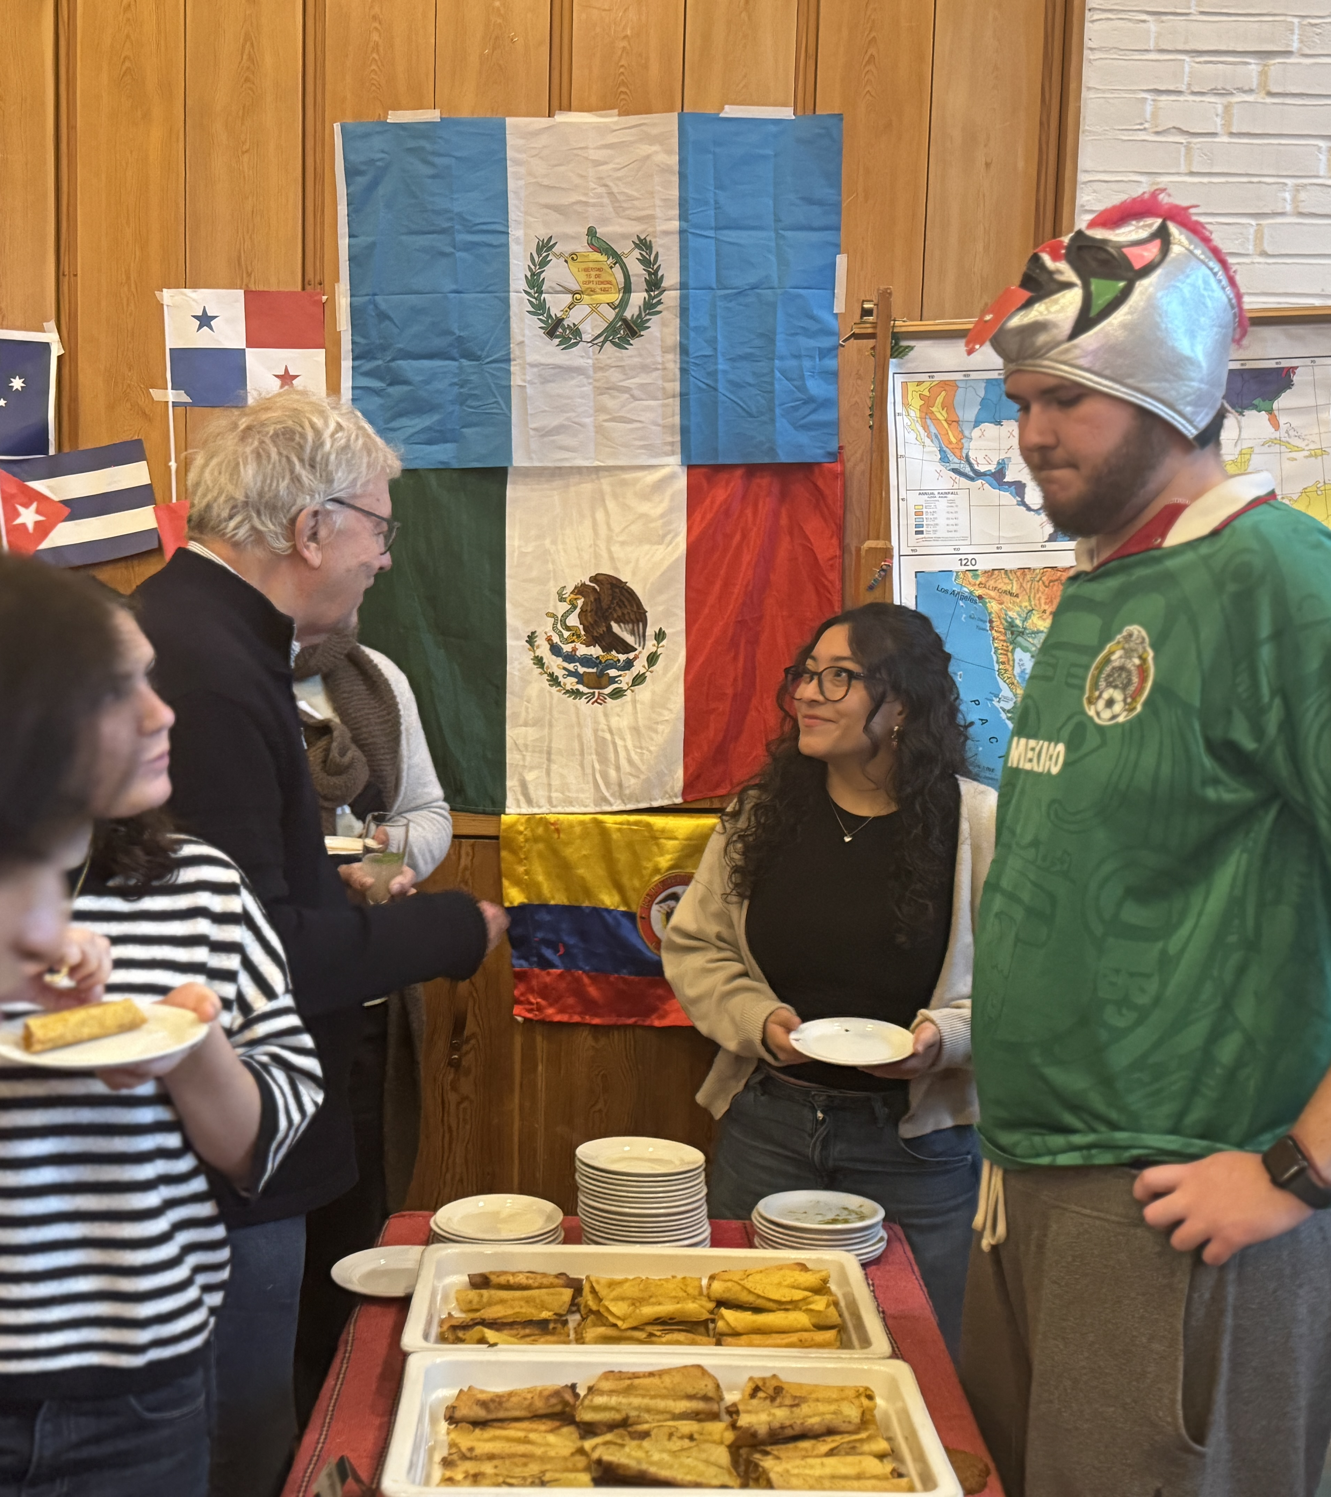
3) Creative Team
The goal is to make your 'booth' inviting, informative, and visually engaging for visitors.
Be creative and use colours, symbols, decorations, and cultural elements that showcase your food stand / activity.

Slide 10
3) Decide on roles
3 students for each team:
Food preps
Setting up
Washing up
Cleaning
The rest: activity / creative team (if it only requires one person, divide to other teams)
Students can be on more teams (not food preps!)

Slide 11
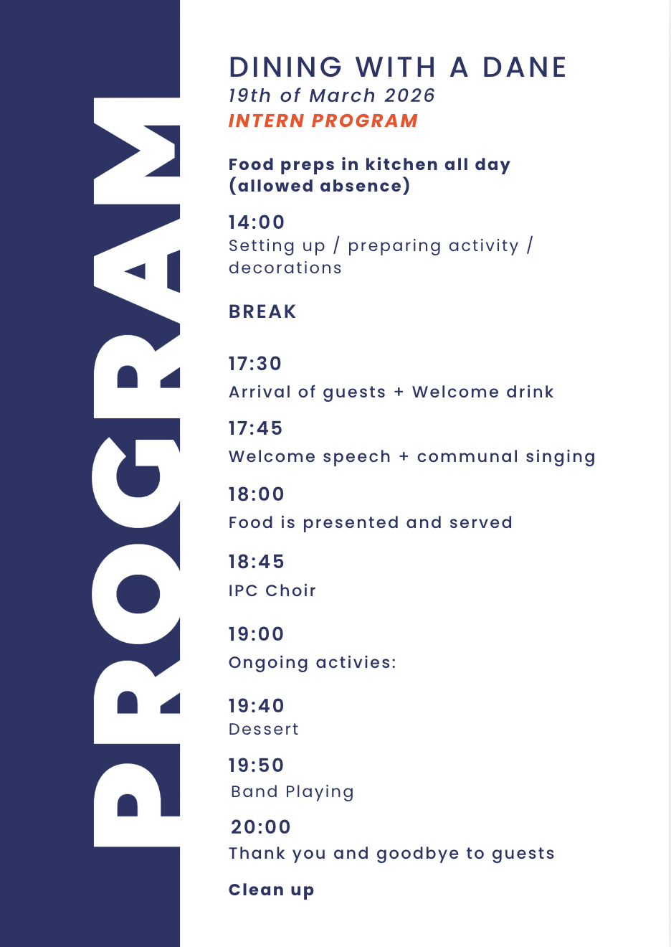

Slide 12
We are all hosts for the night
We prepare, help each other, and clean up together – fællesskab ❤️
If you don’t have a family coming – you are still a host!

Slide 13
Now
In regional groups with anchor teacher:
Fill out the 'Dining with a Dane revisit PAPER'
We meet again to create an overview together
Nb. If any materials need to be ordered, please come to the office to talk about budget (Jette) and ordering (Sara). Materials need to be ordered asap – no later than four days before the revist.
Notes:
Food persons – still a part of the activity decision making now!

